Slide 1
Probabilistic Latent Variable Models for Knowledge Discovery and Optimization
Xiaolong Wang
Department of Computer Science
Oct-17-2016
Doctoral Committee:
Prof. Chengxiang Zhai, Chair
Prof. Jiawei Han
Prof. David Forsyth
Prof. Angelia Nedich, UIUC & ASU
Prof. Joy Ying Zhang, CMU & Facebook

Slide 2
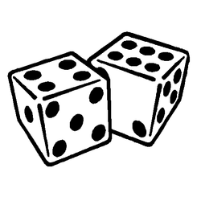
We must become more comfortable with probability and uncertainty
⎻ Nate Silver

Slide 3

An Era of Abundant Data
How To:
Represent the data and knowledge?
Model uncertainty and noise?
Scale well to large data?
Network
Text
Probabilistic Modeling
with Latent Variables
Images

Slide 4
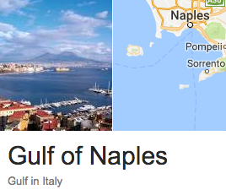
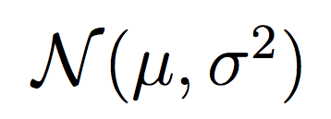
PLVM – An Historical Account
L
1893
W
R = W / L
Ratio of forehead width to the body length of 1000 crabs
Raphael Weldon
1860 - 1906
Karl Pearson
1857 - 1936
“A well-marked deviation from this normal shape”
A single normal fitting with
Maximum Likelihood Estimation (MLE)
“the units grouped together in the measured material are not really homogeneous??”

Slide 5
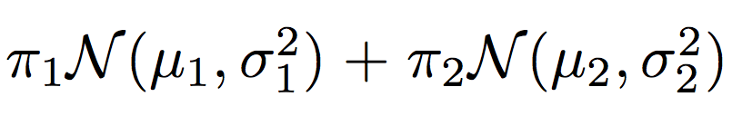
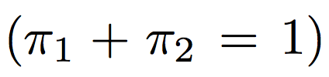
PLVM – An Historical Account
Karl Pearson
1857 - 1936
Model of 5 free variables
Matching on first 5 moments
Solving a 9th-degree polynomial
Two-normal fitting with Moment Matching (MOM)

Slide 6
PLVM – An Historical Account
Raphael Weldon
1860 - 1906
Karl Pearson
1857 - 1936

Slide 7
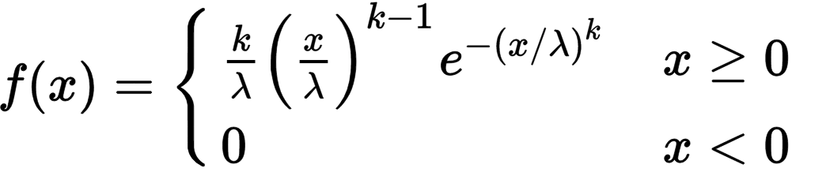
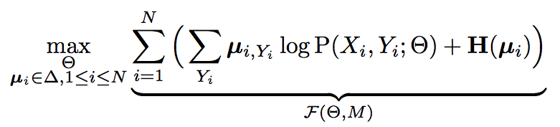
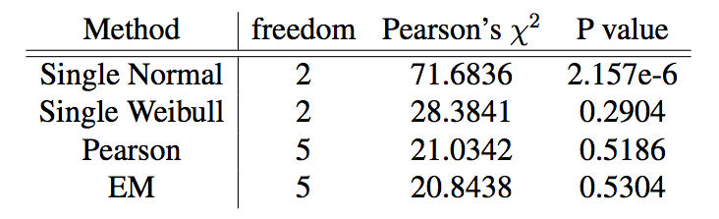
PLVM – An Historical Account
Modern alternatives:
Weibull Distribution
Two-normal with EM
MLE approximation
Why PLVM?
Flexible Modelling
Powerful Tool for KDD
Efficient Optimization
Fréchet (1927)

Slide 8
Citation LDA: Understanding Evolution of Research Themes
Dual Clustering Maximum Entropy
PLANS: Phrasal Latent Allocation with Negative Sampling
Thurstonian Pairwise Preference

Slide 9
The Evolution Graph
Discovering the Research Topics
Topic Milestone Papers
What paper represents the topic?
Topic Temporal Strength
When does the topic emerge/fade?
Topic Keywords
How to summarize the topic?
Discovering the Theme Evolution
Topic Importance
Which topic is more important?
Topic Dependency
Which topic enables other topics?
Evolution Patterns
Do topics merge? or get branched?

Slide 10
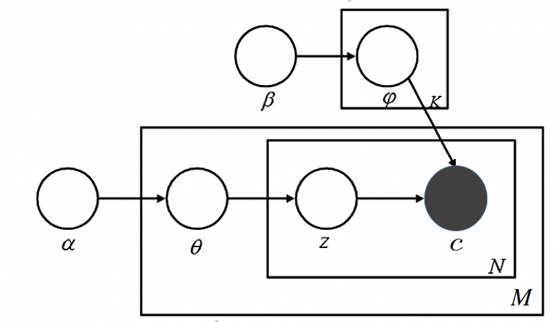
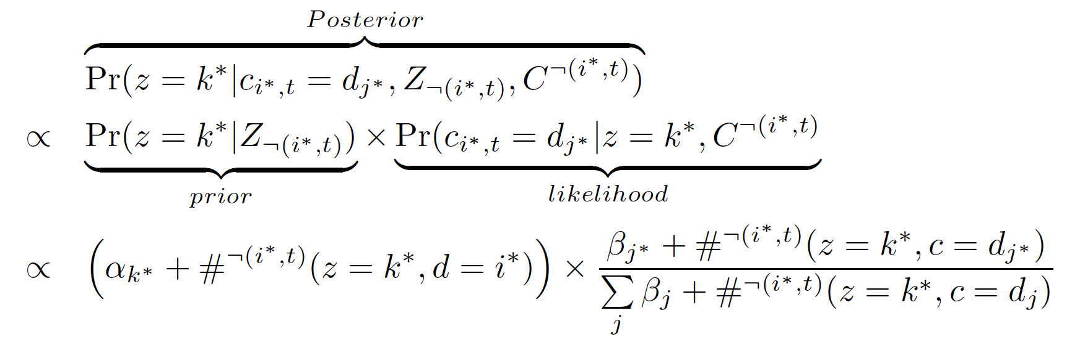
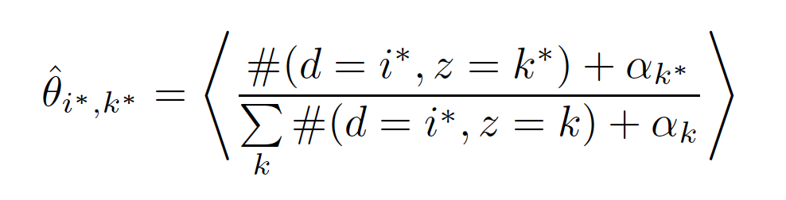
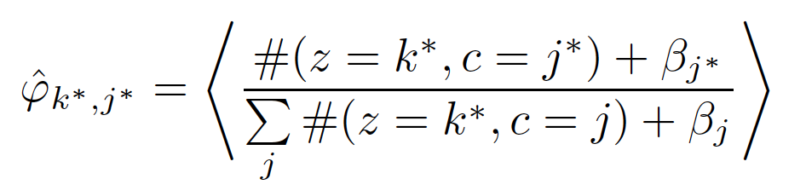
Citation-LDA
Multinomial over Cited Papers Given a Topic
 | LDA | Citation-LDA
Topic | Distribution over Words | Distribution over Cited Papers
Document | Bag of Words | Bag of Cited Papers
Gibbs Sampling of z:
Multinomial over Latent Topics Given a Citing Paper
Posterior Expectation:

Slide 11
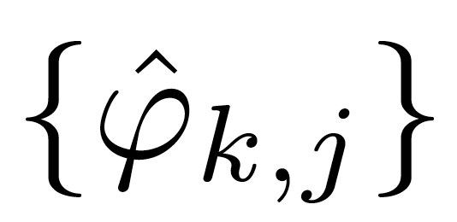
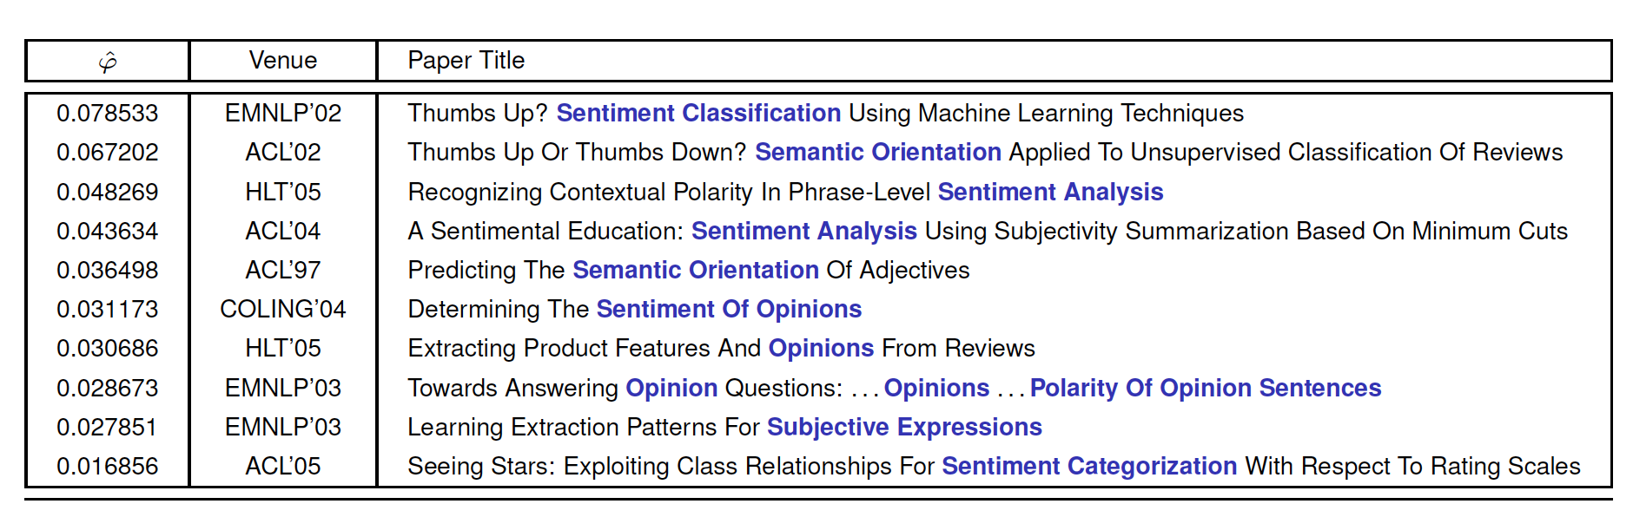
Discovery of Research Topics
1. Topic Milestone Papers
Rank papers by , probability of citing paper j in topic k
ACL Anthology Network (AAN), Topic 89 of 100 Topics

Slide 12
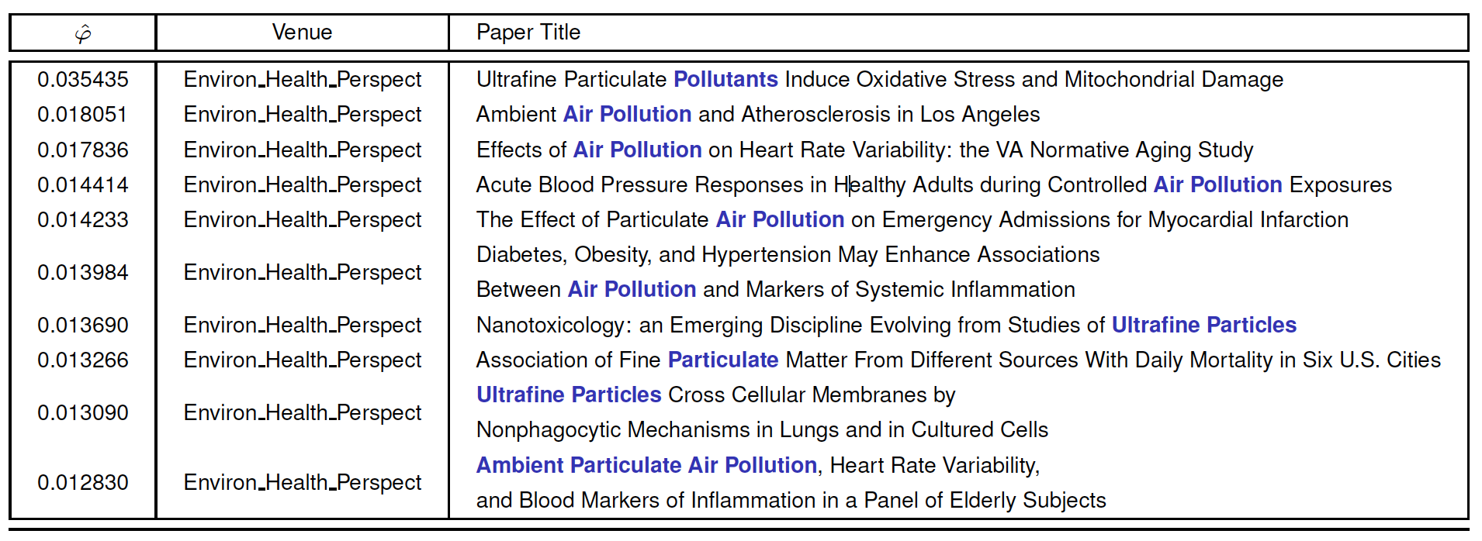
Discovery of Research Topics
1. Topic Milestone Papers
Rank papers by , probability of citing paper j in topic k
PubMed, Topic 175 of 500 Topics

Slide 13
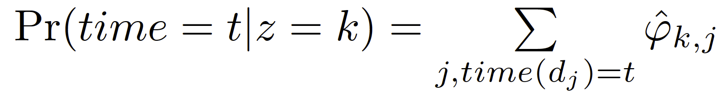
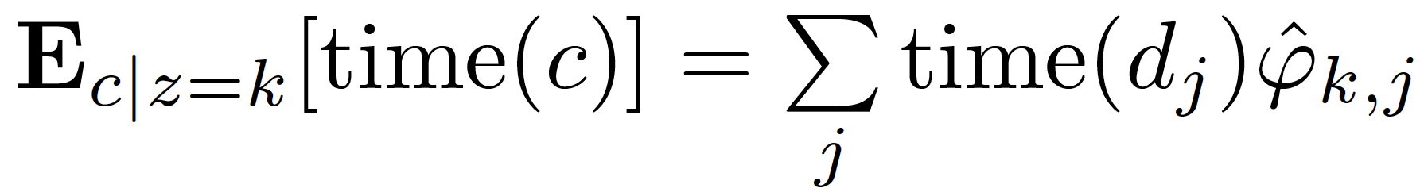
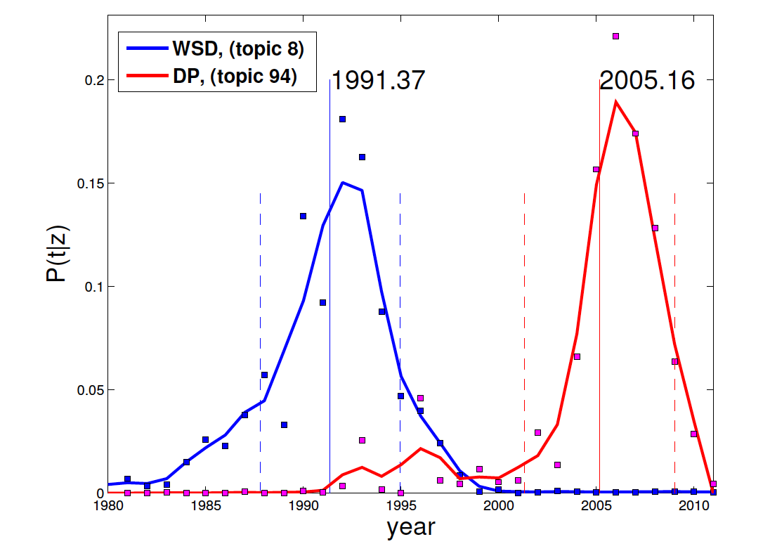
Discovery of Research Topics
2. Topic Temporal Strength
Temporal distribution
Topic expectation time
Word Sense Disambiguation (WSD)
Dependency Parsing (DP)

Slide 14
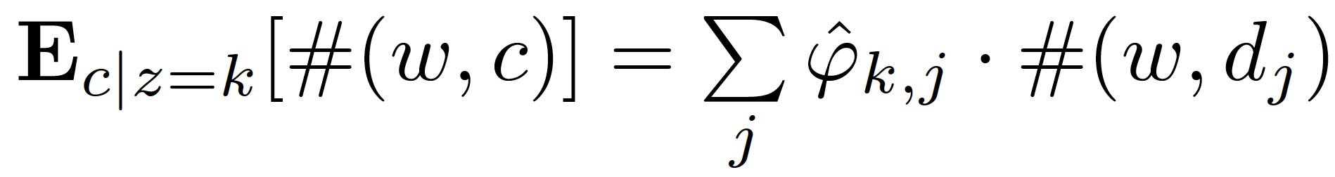
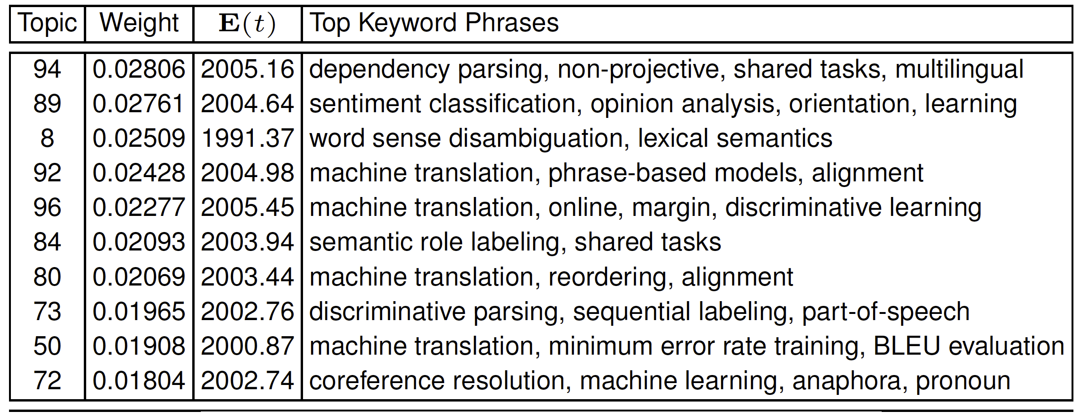
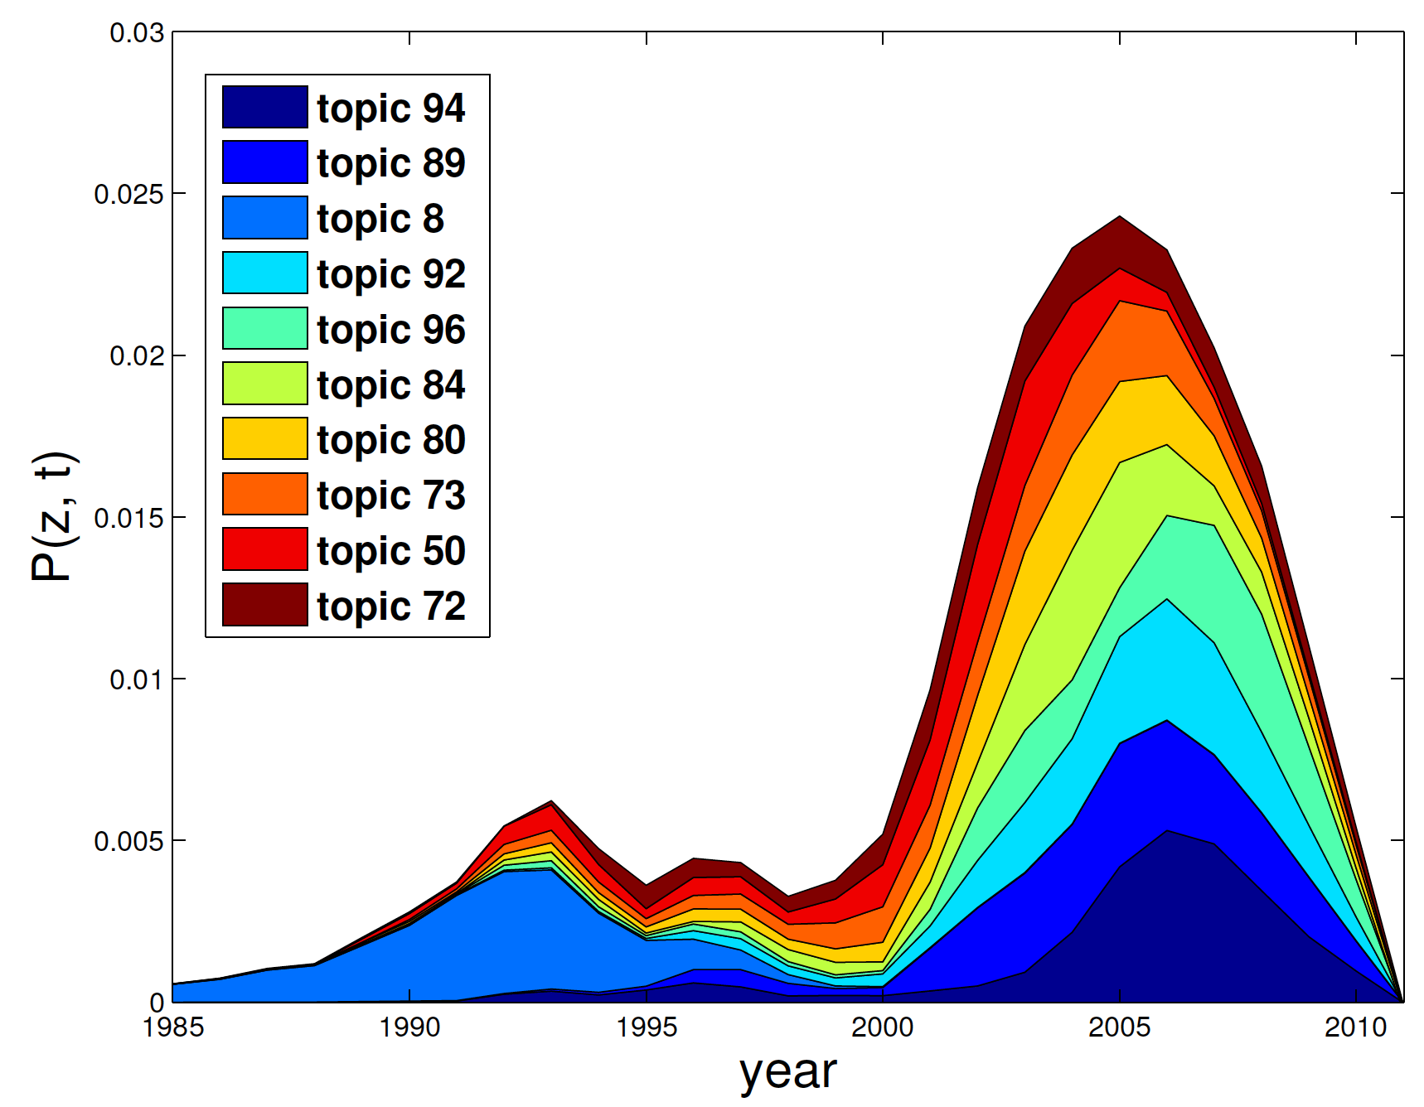
Discovery of Research Topics
3. Topic Keywords
Extract words of title (or abstract)
Top 10 Topics in AAN

Slide 15
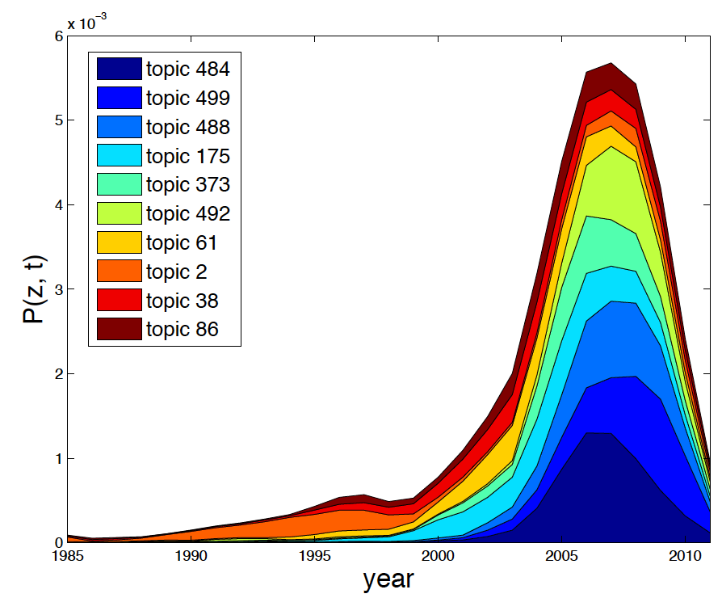
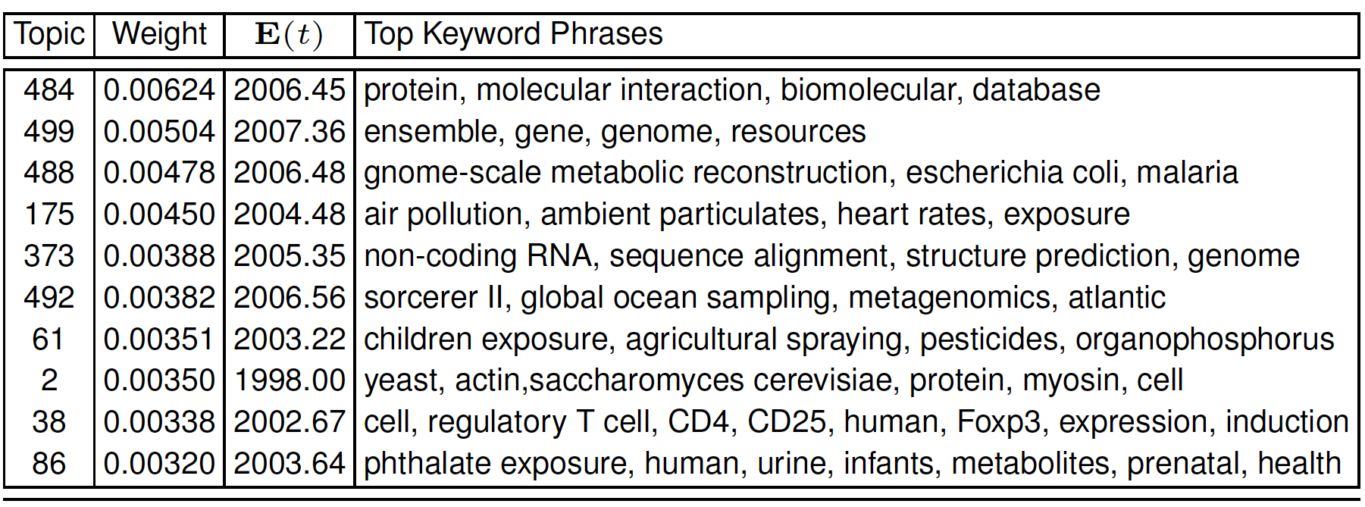
Discovery of Research Topics
3. Topic Keywords
Extract words of title (or abstract)
Top 10 Topics in AAN

Slide 16
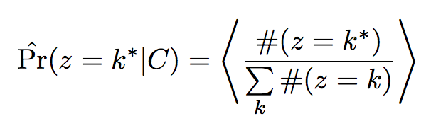
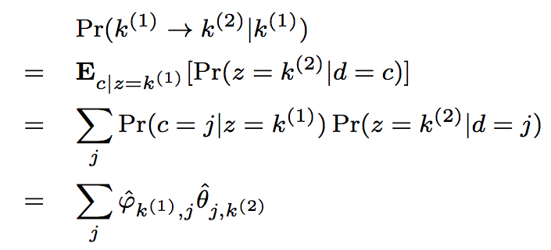
Discovering the Theme Evolution
4. Topic Importance
Rank topic by
5. Topic Dependency
Topic k⁽¹⁾ citing Topic k⁽²⁾
6. Evolution Patterns
Plot the graph
of dependencies
between topics
Chance of paper j citing topic k⁽²⁾
Importance of paper j in topic k⁽¹⁾

Slide 17
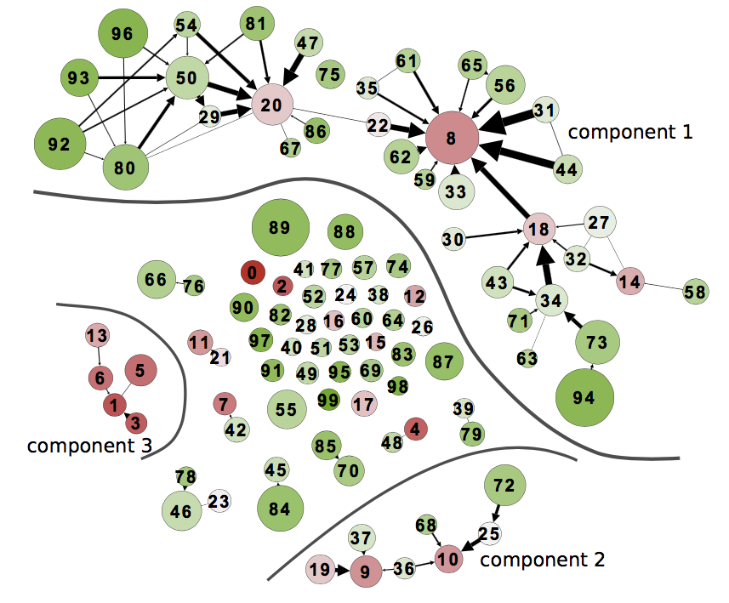
Discovering the Theme Evolution
Word Sense Disambiguation, 91’
Statistical Machine Translation
Prepositional Phrase Attachment, 94’
Statistical Parsing, 99’
Grammars
(faded in 90s)
Discriminative Parsing, 03’
Dependency Parsing, 05’
Discourse/Dialogue
Summarization
AAN

Slide 18
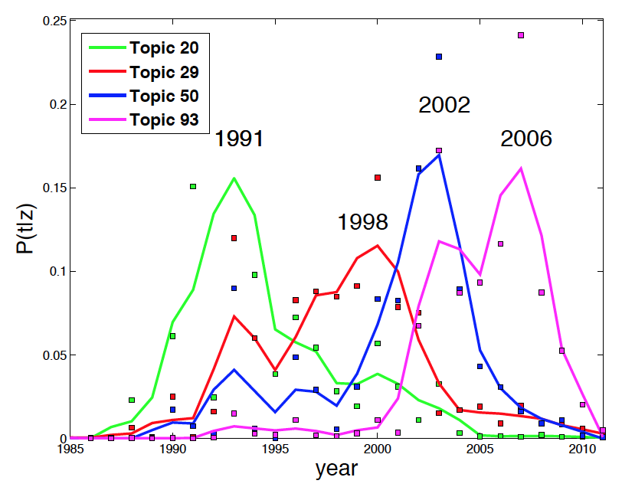
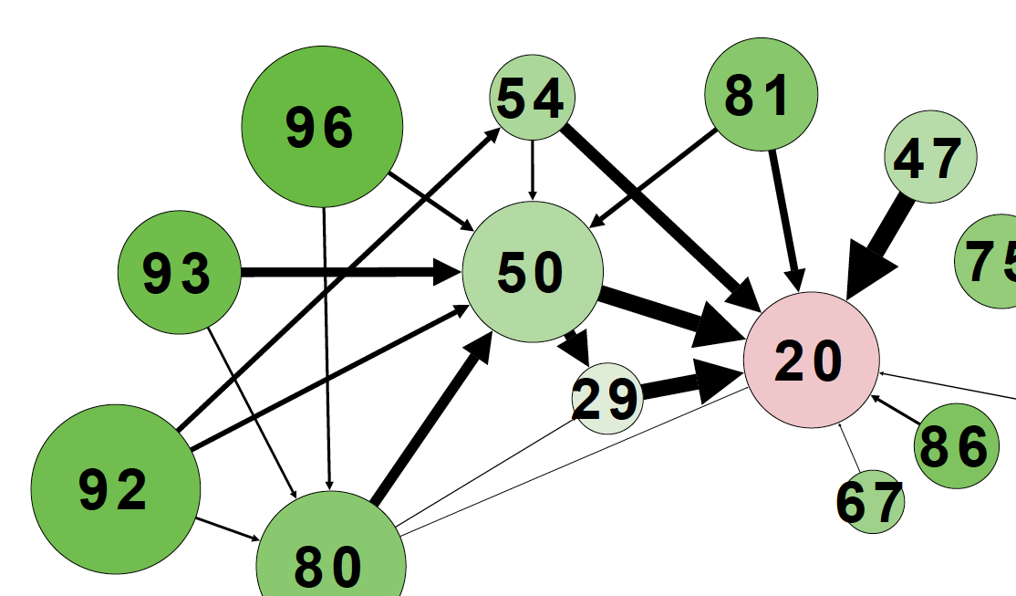
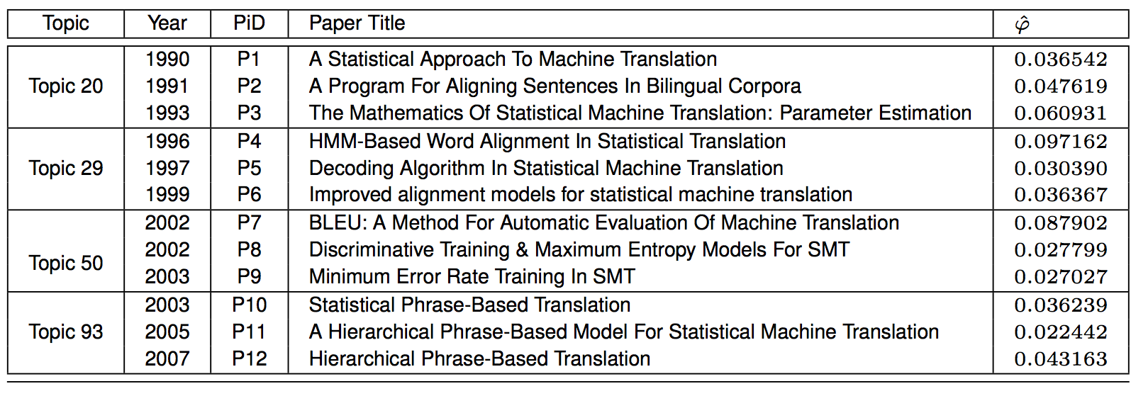
Discovering the Theme Evolution

Slide 19
Citation-LDA: Summary
Modeling citations as a mixture of latent topics
Discovering research topics:
milestone papers, temporal strength, Keywords
Discovery the theme evolution:
topic importance and dependency, theme evolution patterns
Citation-LDA: a general modelling method for network data

Slide 20
Citation LDA: Understanding Evolution of Research Themes
Dual Clustering Maximum Entropy
PLANS: Phrasal Latent Allocation with Negative Sampling
Thurstonian Pairwise Preference

Slide 21


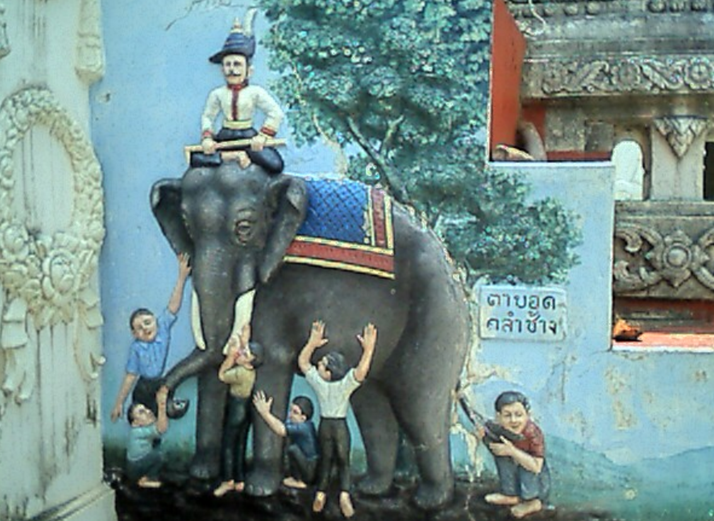



Blind Men and The Elephant: From Ranking to Pairwise Preferences
a Complicated Problem
a Series of Smaller and Easier Tasks
Ranking
annotated by
Experts
Pairwise Preferences
annotated by
Crowd Workers
Thustonian Pairwise Preference (TPP)
Query Difficulty and domain
Worker expertise and truthfulness
Challenges:
Incompleteness and Inconsistency

Slide 22
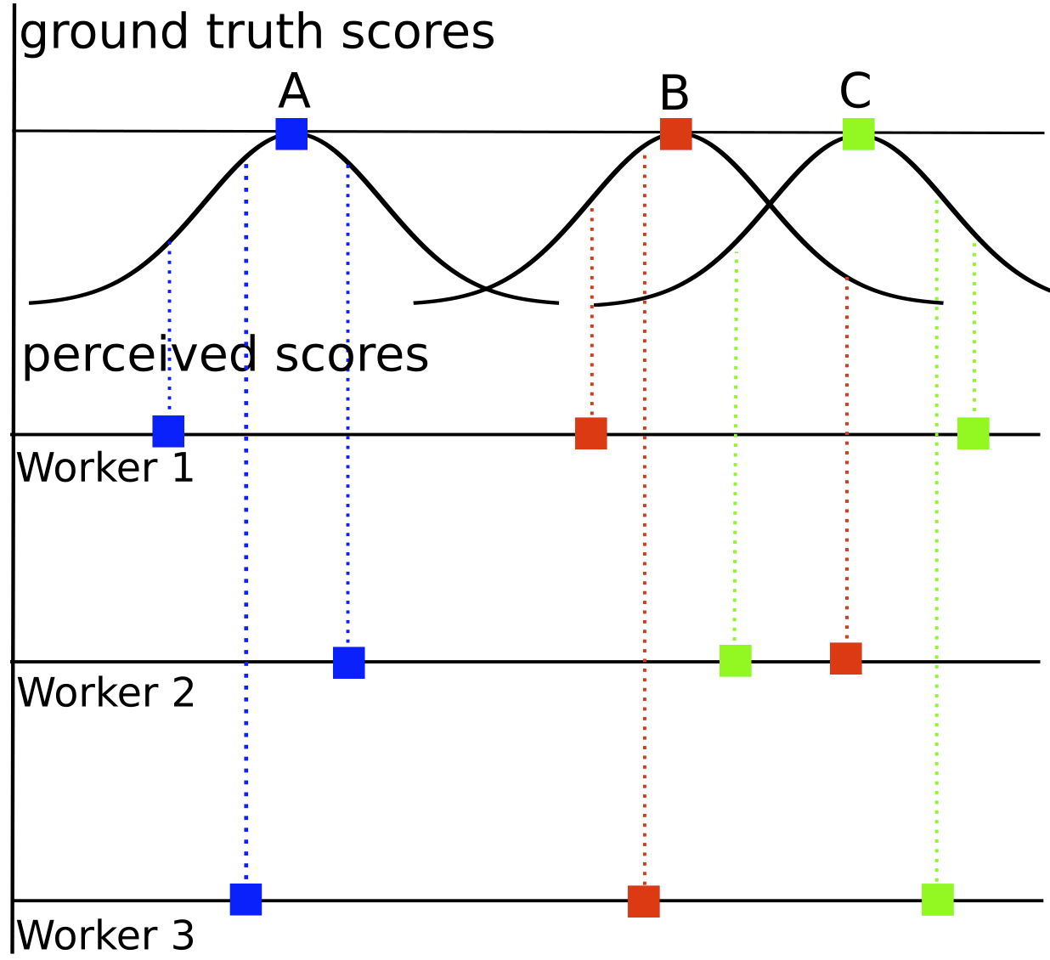
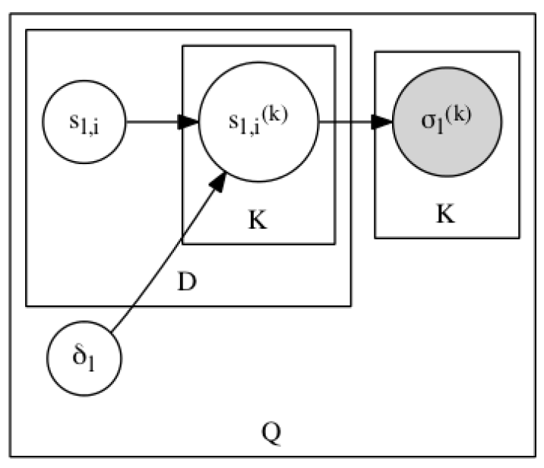
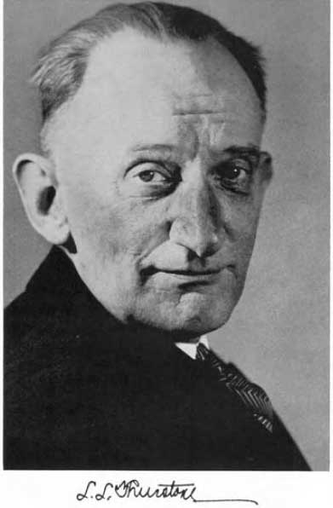



Thurstonian Ranking Model (TRM): PLVM for Ranked Lists
ground truth score (mean)
perceived score
Worker
A > B > C
Doc
Louis Leon Thurstone
1887 - 1955
difficulty (std)
Observation:
ranking
A > C > B
Query
A > B > C
First scalable algorithm
Gibbs sampling
By Ulf Böckenholt (92’-93’), (was) a UIUC Professor
Which one or what is the true ranking?
TRM is a PLVM modelling ranked lists as judgements following normal distributions
Ulf Böckenholt

Slide 23
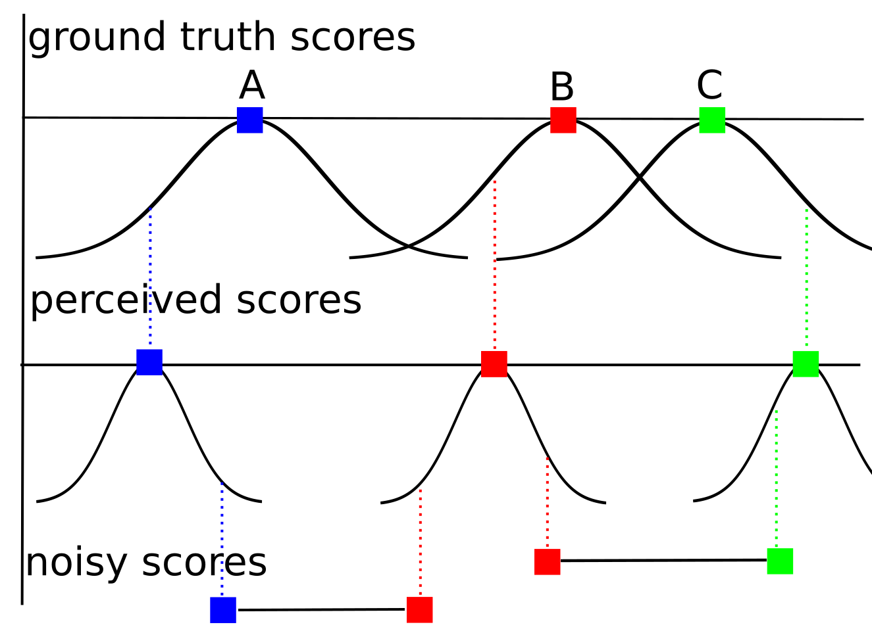
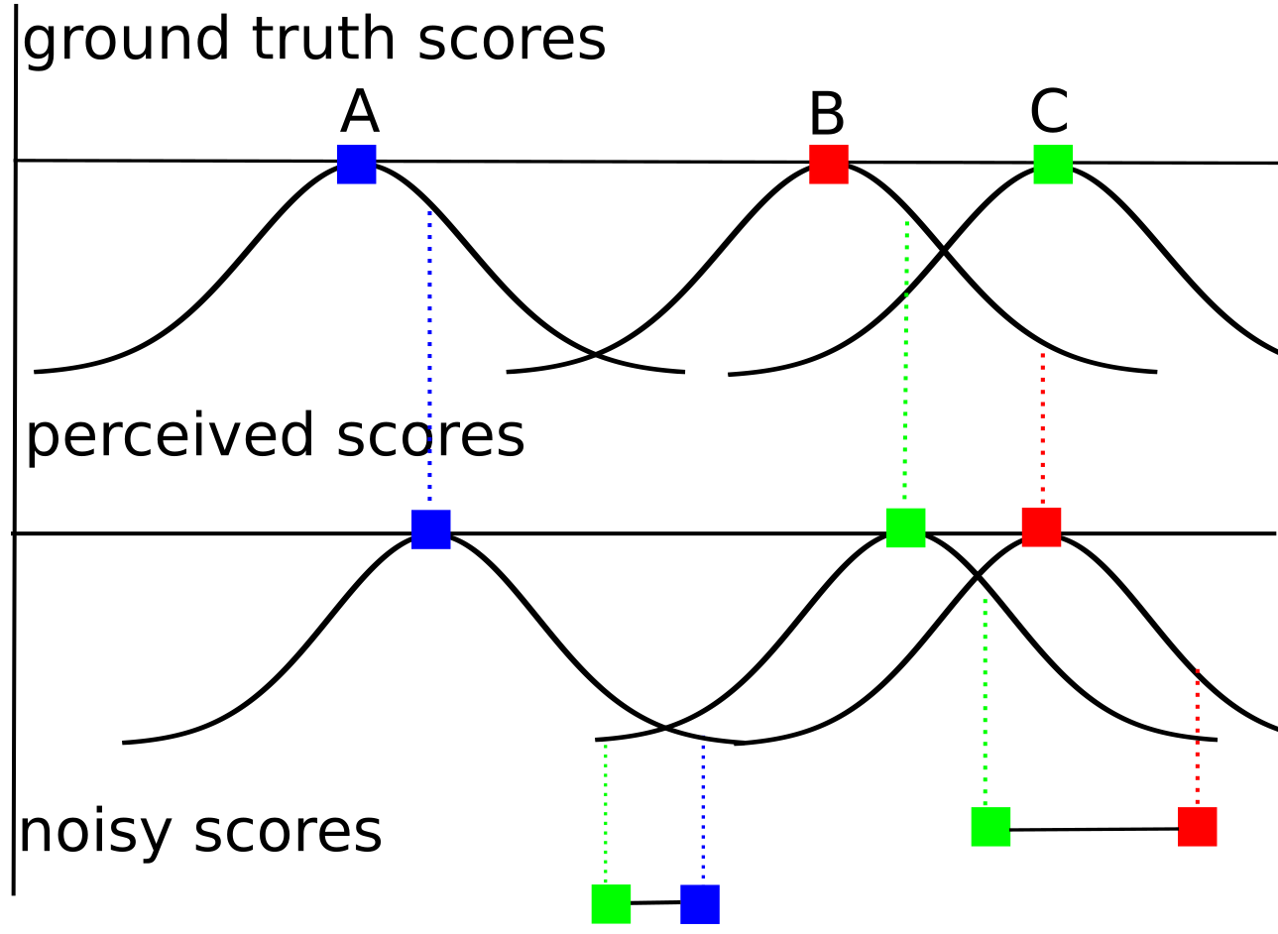
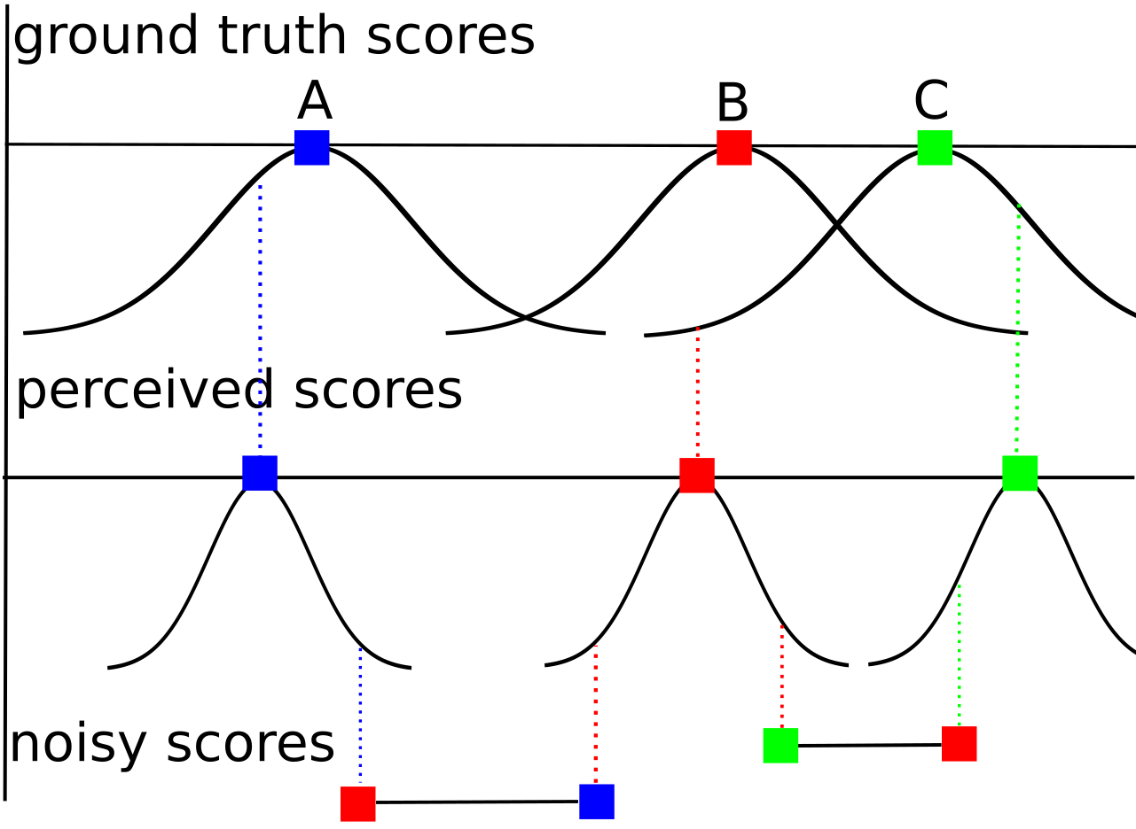

Thustonian Pairwise Preference (TPP): PLVM for Pairwise judgements
Modelling Pairwise Preferences:
No Error
Error due to Low Expertise
Error due to “Flipping”
Expert (on the query domain)
Truthful
Limited expertise
Truthful
Expert
Malicious
Error due to Difficult Query

Slide 24
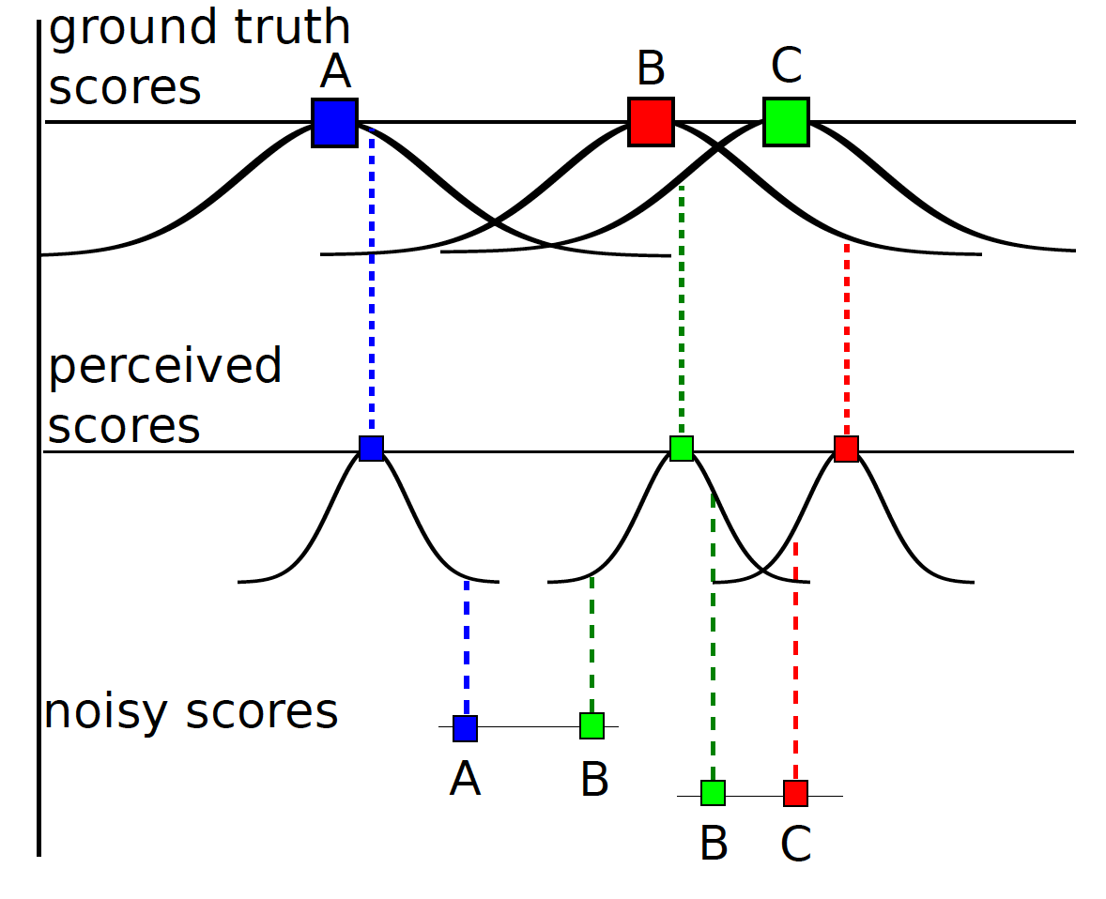
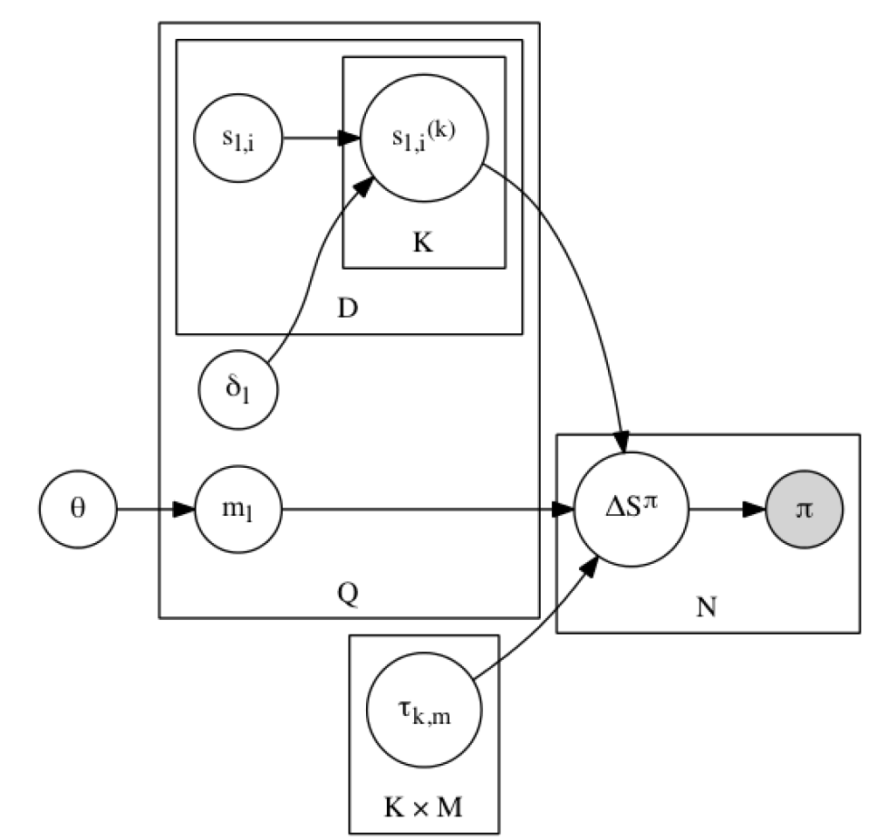
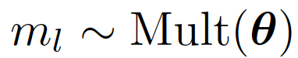
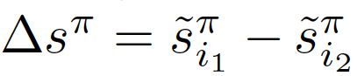
Thustonian Pairwise Preference
ground truth score (mean)
perceived score
(mean)
Worker
Doc
noisy score difference
query domain
mixture prior
difficulty (std)
TRM
domain
Judgement
query domain:
Query
expertise and
truthfulness (std)
Observation:
pairwise preference
noisy score:
Worker ☓ Domain
difference:

Slide 25

Thustonian Pairwise Preference
noisy score:
difference:
spammer
$$τ$$
malicious
0
expert

Slide 26
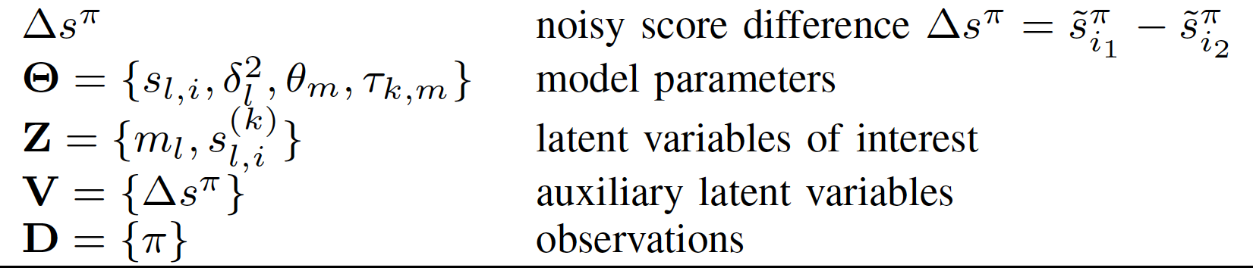
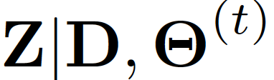
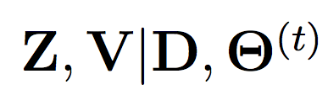
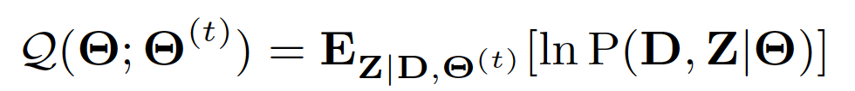
Thustonian Pairwise Preference
EM algorithm:
intractable posterior
E-step
sampling-friendly posterior
M-step

Slide 27
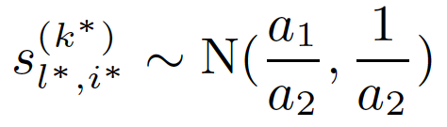
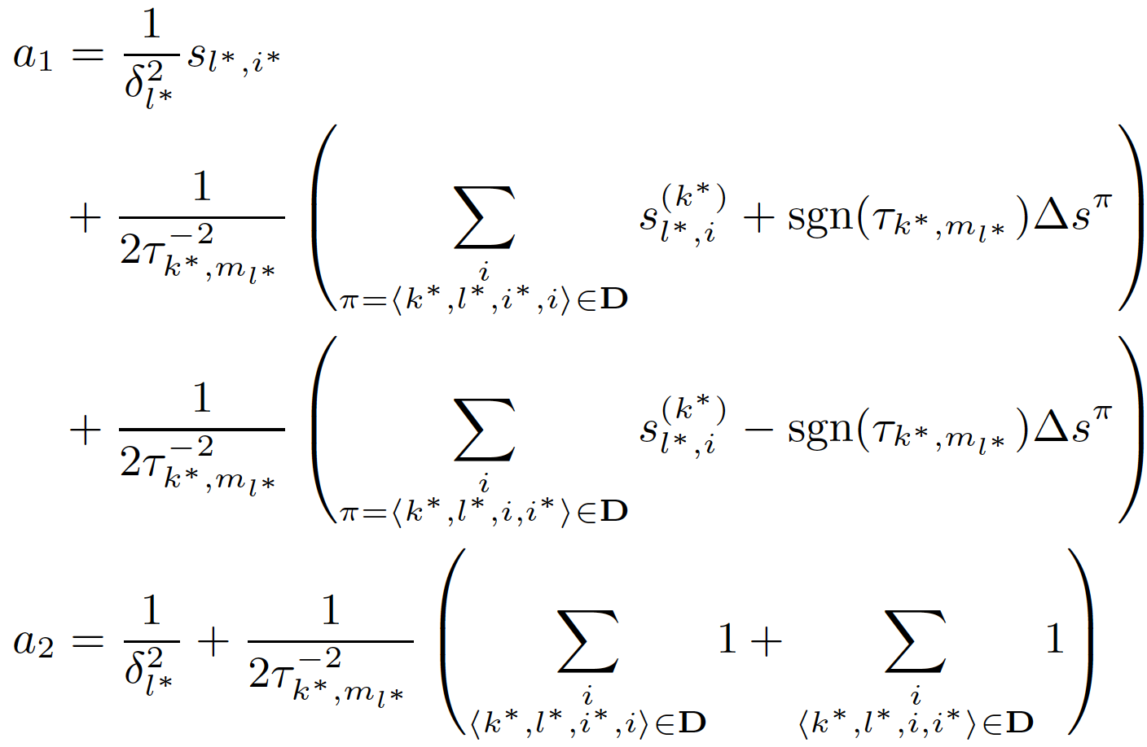
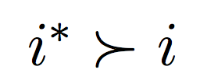
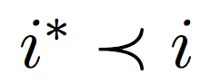
TPP: Learning by Comparison
E-step
Sample perceived score:
winning
Losing
query difficulty
domain expertise

Slide 28
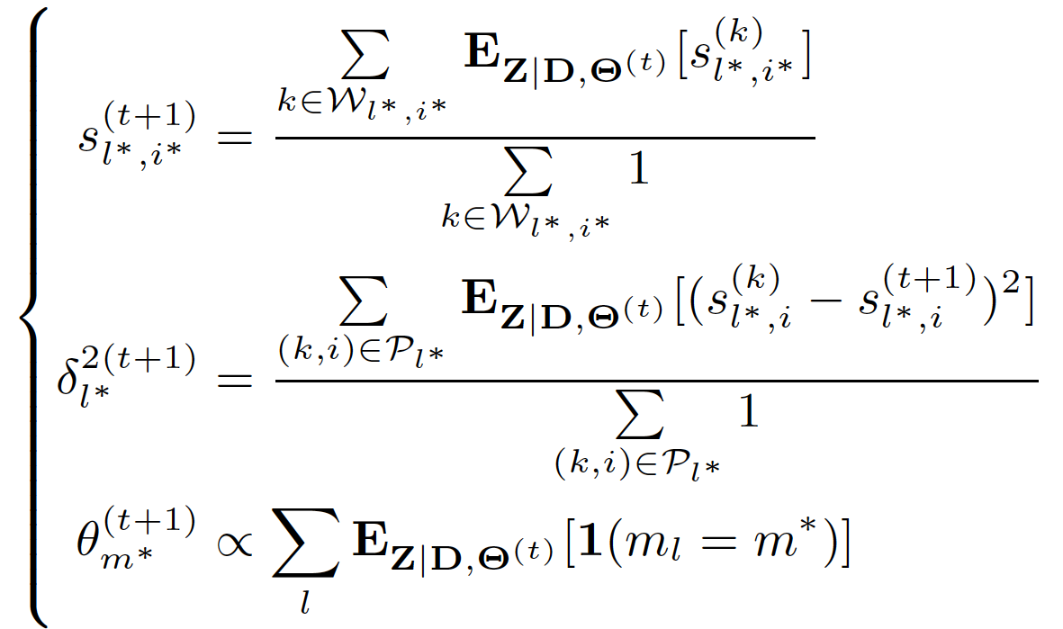
TPP: Majority Voting
M-step
empirical mean of samples
empirical variance
of samples
empirical multinomial
of samples

Slide 29
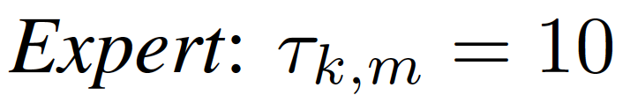





TPP: Simulated Study
0.2
0.6
0.1
0.1
Demo 1
0.2
0.4
0.3
0.1
Demo 2
0.2
0.4
0.1
0.3
Demo 3
5 docs
30 docs
full model
same worker expertise
(Chen et al., 2013)
only 1 domain
same query difficulty

Slide 30


TPP: Domain Prediction and Efficiency

Slide 31

TPP: Malicious Worker Detection
100/200 annotators
10 malicious workers in 100 group
20 malicious workers in 200 group
Sparsity ratio
0.01 (4.35 out of 435 pairs)
0.02 (8.7 out of 435 pairs)

Slide 32

TPP: Rank Aggregation
25 retrieval systems
25 workers for TPP
Baselines work with rankings:
TRM
BordaCount
Majority Voting for Ranking

Slide 33
TPP: Summary
Modeling Pairwise Preferences in Crowdsourcing by
extending Thurstonian Ranking Model
explaining errors/uncertainty with a multitude of sources
Knowledge Discovering
query difficulty, query domain
worker domain expertise, worker truthfulness
Efficient Optimization
EM algorithm: E-step by sampling

Slide 34
Citation LDA: Understanding Evolution of Research Themes
Dual Clustering Maximum Entropy
PLANS: Phrasal Latent Allocation with Negative Sampling
Thurstonian Pairwise Preference

Slide 35


Maximum Entropy: A Versatile Tool
Maximum Entropy (ME) Framework:
Classification: with known feature vector
hypothesis for
positive class
t-th feature
vector
x_{t}
hypothesis for
negative class
w₁
w₂
f_{t}(neg)
f_{t}(pos)

Slide 36


Maximum Entropy: A Versatile Tool
Maximum Entropy (ME) Framework:
Embedding: with unknown feature vector (representation)
recursive ?? network
?? = neural vs ?? = social
f_{t}(neural)
Continuous Bag-of-Words (CBOW)
(Milokov et al. 2013)
v_{neural}
h_{network}
h_{recursive}
v_{social}
f_{t}(social)

Slide 37

Maximum Entropy: Difficulty in Scaling
Classes: >10☓E4 MeSH (Medical Subject Heading) tags
Vocabulary: >1M words
How Does Gradient Descent (GD) of ME works?
w₁
x_{t}
w₂
f_{t}(1)
w₃
3-class classification

Slide 38
Maximum Entropy: Difficulty in Scaling
Classes: >10☓E4 MeSH (Medical Subject Heading) tags
Vocabulary: >1M words
How Does Gradient Descent (GD) of ME works?
w₁
x_{t}
w₂
f_{t}(2)
w₃
3-class classification

Slide 39
Maximum Entropy: Difficulty in Scaling
Classes: >10☓E4 MeSH (Medical Subject Heading) tags
Vocabulary: >1M words
How Does Gradient Descent (GD) of ME works?
w₁
x_{t}
w₂
f_{t}(3)
w₃
3-class classification

Slide 40




Maximum Entropy: Difficulty in Scaling
Classes: >10☓E4 MeSH (Medical Subject Heading) tags
Vocabulary: >1M words
How Does Gradient Descent (GD) of ME works?
w₁
suppose y_{t} = 1, gradient descent updates:
x_{t}
w₂
w₃
3-class classification

Slide 41
Maximum Entropy: Difficulty in Scaling
Classes: >10☓E4 MeSH (Medical Subject Heading) tags
Vocabulary: >1M words
How Does Gradient Descent (GD) of ME works?
w₁
suppose y_{t} = 1, gradient descent updates:
x_{t}
w₂
w₃
3-class classification

Slide 42
Maximum Entropy: Difficulty in Scaling
Classes: >10☓E4 MeSH (Medical Subject Heading) tags
Vocabulary: >1M words
How Does Gradient Descent (GD) of ME works?
w₁
suppose y_{t} = 1, gradient descent updates:
x_{t}
w₂
w₃
3-class classification

Slide 43
Maximum Entropy: Difficulty in Scaling
Classes: >10☓E4 MeSH (Medical Subject Heading) tags
Vocabulary: >1M words
How Does Gradient Descent (GD) of ME works?
w₁
GD Complexity:
O(DN)
D – feature dimensionality
N – number of classes
suppose y_{t} = 1, gradient descent updates:
x_{t}
w₂
3-class classification
w₃

Slide 44


Dual-Clustering Maximum Entropy (DCME)
w₁
w₁
x_{t}
w₁
x_{t}
w₂
w₂
w₂
GD Complexity:
O(DN)
D – feature dimensionality
N – number of classes
x_{t}
w₃
w₃
w₃
t = 1, y_{t} =1
t = 2, y_{t} =2
t = 3, y_{t} = 3
Insight:
If distributions P_{t} are same,
computation in online/offline is efficient
x₁
x₂
w₁
w₂
x₃
w₃

Slide 45
Dual-Clustering Maximum Entropy (DCME)
w₁
w₁
x_{t}
w₁
x_{t}
w₂
w₂
w₂
GD Complexity:
O(DN)
D – feature dimensionality
N – number of classes
x_{t}
w₃
w₃
w₃
t = 1, y_{t} =1
t = 2, y_{t} =2
t = 3, y_{t} = 3
Insight:
If distributions P_{t} are same,
computation in online/offline is efficient
x₁
w₁
x₂
w₂
w₃
x₃

Slide 46
Dual-Clustering Maximum Entropy (DCME)
w₁
w₁
x_{t}
w₁
x_{t}
w₂
w₂
w₂
GD Complexity:
O(DN)
D – feature dimensionality
N – number of classes
x_{t}
w₃
w₃
w₃
t = 1, y_{t} =1
t = 2, y_{t} =2
t = 3, y_{t} = 3
x₃
Insight:
If distributions P_{t} are same,
computation in online/offline is efficient
x₂
x₁

Slide 47




Dual-Clustering Maximum Entropy (DCME)
w₁
w₁
x_{t}
w₁
x_{t}
w₂
w₂
w₂
GD Complexity:
O(DN)
D – feature dimensionality
N – number of classes
x_{t}
w₃
w₃
w₃
t = 1, y_{t} =1
t = 2, y_{t} =2
t = 3, y_{t} = 3
x₃
Insight:
If distributions P_{t} are same,
computation in online/offline is efficient
x₂
x₁ + x₂ + x₃
x₁
w₁
w₂
w₃

Slide 48
Dual-Clustering Maximum Entropy (DCME)
w₁
w₁
x_{t}
w₁
x_{t}
w₂
w₂
w₂
DCME Complexity:
O(DK)
D – feature dimensionality
K – number of clusters
if mini-batch size = O(N)
x_{t}
w₃
w₃
w₃
t = 1
t = 2
t = 3
Goal:
Complexity Independent of N
Solution:
Approximating/Clustering P_{t}(i), i=1 … N
Which distribution
P is optimal?

Slide 49



DCME: Primal-Dual ME
Conjugate between Log Partition and Negative Entropy:

Slide 50



DCME: Primal-Dual ME
Conjugate between Log Partition and Negative Entropy:
Maximum Entropy
Primal-Dual ME

Slide 51



DCME: Primal-Dual ME
Primal-Dual ME
Dual-Clustering ME

Slide 52


DCME: Dual-Clustering
Using Conjugate
Again!
Updating cluster assignments (Online):
Updating cluster centers (Offline)

Slide 53

DCME: Dual-Clustering
Dual-Clustering:
K-means with Two Ingredients:
Clustering in the Simplex Space
Instead of Euclidean space
Measuring “Distance” in KL Divergence
Instead of L₂ distance

Slide 54


DCME: Dual Form as Feature Pursuit
DCME:
ME:

Slide 55

DCME: Experiment on Classification and Embedding
Baselines:
Gradient Descent
Noise-Contrastive Estimation
Negative Sampling
(Mikolov et al. 2013 )

Slide 56
DCME: Summary
Modeling Dual Distributions in Maximum Entropy:
K-means latent clustering
Approximating each distribution by the corresponding cluster mean
Scalable Optimization:
A hybrid online-offline algorithm
Complexity depends only on #cluster, but not #class
Effective model update: no sampling involved

Slide 57
Citation LDA: Understanding Evolution of Research Themes
Dual Clustering Maximum Entropy
PLANS: Phrasal Latent Allocation with Negative Sampling
Thurstonian Pairwise Preference

Slide 58

Embedding: Beyond Word Representation
Word Embedding: A Skipgram Scheme
W_{t-2}
W_{t-1}
W_{t}
W_{t+1}
W_{t+2}
Maximize: log P(w_{t-2}|w_{t})

Slide 59

Embedding: Beyond Word Representation
Word Embedding: A Skipgram Scheme
W_{t-2}
W_{t-1}
W_{t}
W_{t+1}
W_{t+2}
Maximize: log P(w_{t-2}|w_{t}) + log P(w_{t-1}|w_{t})

Slide 60

Embedding: Beyond Word Representation
Word Embedding: A Skipgram Scheme
W_{t-2}
W_{t-1}
W_{t}
W_{t+1}
W_{t+2}
Maximize: log P(w_{t-2}|w_{t}) + log P(w_{t-1}|w_{t}) + log P(w_{t+1}|w_{t})

Slide 61

Embedding: Beyond Word Representation
Word Embedding: A Skipgram Scheme
W_{t-2}
W_{t-1}
W_{t}
W_{t+1}
W_{t+2}
Maximize: log P(w_{t-2}|w_{t}) + log P(w_{t-1}|w_{t}) + log P(w_{t+1}|w_{t}) + log P(w_{t+2}|w_{t})
Limitations of Bag-of-Words Assumption:
Words are contextually unaware
bank
“I made a deposit in the bank.”
“We walked on the river bank.”

Slide 62
Embedding: Beyond Word Representation
Word Embedding: A Skipgram Scheme
W_{t-2}
W_{t-1}
W_{t}
W_{t+1}
W_{t+2}
Maximize: log P(w_{t-2}|w_{t}) + log P(w_{t-1}|w_{t}) + log P(w_{t+1}|w_{t}) + log P(w_{t+2}|w_{t})
Limitations of Bag-of-Words Assumption:
Words are contextually unaware
Sentence is simple average of words
presidential residence
the White House
a house in white
Machine
Human

Slide 63
PLANS: Phrasal Latent Allocation with Negative Sampling
Jointly Learning of:
Phrasal Allocation
computer
scientists
working
in
artificial
intelligence
and
machine
learning
artificial

Slide 64
PLANS: Phrasal Latent Allocation with Negative Sampling
Jointly Learning of:
Phrasal Allocation
computer
scientists
working
in
artificial
intelligence
and
machine
learning
in artificial

Slide 65
PLANS: Phrasal Latent Allocation with Negative Sampling
Jointly Learning of:
Phrasal Allocation
computer
scientists
working
in
artificial
intelligence
and
machine
learning
working in artificial

Slide 66
PLANS: Phrasal Latent Allocation with Negative Sampling
Jointly Learning of:
Phrasal Allocation
computer
scientists
working
in
artificial
intelligence
and
machine
learning
in artificial intelligence

Slide 67
PLANS: Phrasal Latent Allocation with Negative Sampling
Jointly Learning of:
Phrasal Allocation
computer
scientists
working
in
artificial
intelligence
and
machine
learning
artificial intelligence and

Slide 68
PLANS: Phrasal Latent Allocation with Negative Sampling
Jointly Learning of:
Phrasal Allocation
computer
scientists
working
in
artificial
intelligence
and
machine
learning
artificial intelligence

Slide 69




PLANS: Phrasal Latent Allocation with Negative Sampling
Jointly Learning of:
Phrasal Allocation
Embedding Estimation
computer
scientists
working
in
artificial
intelligence
and
machine
learning
artificial intelligence
artificial intelligence
algorithm
machine learning
artificial food additives
Embedding space

Slide 70


PLANS: Ingredient 1 Transient Chinese Restaurant Process
Chinese Restaurant Process
…

Slide 71

PLANS: Ingredient 1 Transient Chinese Restaurant Process
Chinese Restaurant Process
…
1
$$α$$

Slide 72
PLANS: Ingredient 1 Transient Chinese Restaurant Process
Chinese Restaurant Process
…
1
$$α$$

Slide 73
PLANS: Ingredient 1 Transient Chinese Restaurant Process
Chinese Restaurant Process
…
2
$$α$$

Slide 74
PLANS: Ingredient 1 Transient Chinese Restaurant Process
Chinese Restaurant Process
…
2
$$α$$

Slide 75
PLANS: Ingredient 1 Transient Chinese Restaurant Process
Chinese Restaurant Process
…
2
1
$$α$$

Slide 76
PLANS: Ingredient 1 Transient Chinese Restaurant Process
Chinese Restaurant Process
…
2
1
$$α$$

Slide 77
PLANS: Ingredient 1 Transient Chinese Restaurant Process
Chinese Restaurant Process
…
2
1
1
$$α$$

Slide 78
PLANS: Ingredient 1 Transient Chinese Restaurant Process
Chinese Restaurant Process
…
2
1
1
$$α$$

Slide 79
PLANS: Ingredient 1 Transient Chinese Restaurant Process
Chinese Restaurant Process
…
3
1
1
$$α$$

Slide 80
PLANS: Ingredient 1 Transient Chinese Restaurant Process
Transient Chinese Restaurant Process
Seating choice is limited to possible phrases only
…
intelligence 1/3
artificial intelligence 1/3
intelligence algorithms 1/3
artificial intelligence algorithms

Slide 81
PLANS: Ingredient 1 Transient Chinese Restaurant Process
Transient Chinese Restaurant Process
Seating choice is limited to possible phrases only
…
intelligence
intelligence 1/3
artificial intelligence 1/3
intelligence algorithms 1/3
artificial intelligence algorithms

Slide 82

PLANS: Ingredient 1 Transient Chinese Restaurant Process
Transient Chinese Restaurant Process
Seating choice is limited to possible phrases only
…
intelligence
1
$$α$$
intelligence 1
machine intelligence $α$/2
intelligence algorithms $α$/2
machine intelligence algorithms

Slide 83
PLANS: Ingredient 1 Transient Chinese Restaurant Process
Transient Chinese Restaurant Process
Seating choice is limited to possible phrases only
…
intelligence
2
$$α$$
intelligence 1
machine intelligence $α$/2
intelligence algorithms $α$/2
machine intelligence algorithms

Slide 84

PLANS: Ingredient 1 Transient Chinese Restaurant Process
Transient Chinese Restaurant Process
Seating choice is limited to possible phrases only
…
intelligence
2
$$α$$
intelligence 2
artificial intelligence $α$/2
intelligence technique $α$/2
artificial intelligence technique

Slide 85
PLANS: Ingredient 1 Transient Chinese Restaurant Process
Transient Chinese Restaurant Process
Seating choice is limited to possible phrases only
…
intelligence
AI
2
1
$$α$$
intelligence 2
artificial intelligence $α$/2
intelligence technique $α$/2
artificial intelligence technique

Slide 86

PLANS: Ingredient 1 Transient Chinese Restaurant Process
Transient Chinese Restaurant Process
Seating choice is limited to possible phrases only
…
intelligence
AI
2
1
$$α$$
artifical $α\text{/2}$
artificial intelligence 1
in artificial $α$/2
in artifical intelligence

Slide 87
PLANS: Ingredient 1 Transient Chinese Restaurant Process
Transient Chinese Restaurant Process
Seating choice is limited to possible phrases only
…
intelligence
AI
2
2
$$α$$
artifical $α\text{/2}$
artificial intelligence 1
in artificial $α$/2
in artifical intelligence

Slide 88

PLANS: Ingredient 1 Transient Chinese Restaurant Process
Transient Chinese Restaurant Process
Seating choice is limited to possible phrases only
…
intelligence
AI
2
2
$$α$$
theory $α\text{/}$3
learning theory $α\text{/}$3
theory paper $α$/3
learning theory paper

Slide 89
PLANS: Ingredient 1 Transient Chinese Restaurant Process
Transient Chinese Restaurant Process
Seating choice is limited to possible phrases only
…
intelligence
AI
learning theory
2
2
1
$$α$$
theory $α\text{/}$3
learning theory $α\text{/}$3
theory paper $α$/3
learning theory paper

Slide 90

PLANS: Ingredient 1 Transient Chinese Restaurant Process
Transient Chinese Restaurant Process
Seating choice is limited to possible phrases only
…
After a minibatch processed:
Customers leave with probability $β$
Retain only the Top V tables
intelligence
AI
learning theory
ML
6
4
2
4
$$α$$

Slide 91


PLANS: Ingredient 1 Transient Chinese Restaurant Process
Transient Chinese Restaurant Process
Seating choice is limited to possible phrases only
…
After a minibatch processed:
Customers leave with probability $β$
Retain only the Top V tables
intelligence
AI
learning theory
ML
6
4
2
4
$$α$$
Shrink
(aging)
3
2
1
2
$β$=0.5

Slide 92
PLANS: Ingredient 1 Transient Chinese Restaurant Process
Transient Chinese Restaurant Process
Seating choice is limited to possible phrases only
…
After a minibatch processed:
Customers leave with probability $β$
Retain only the Top V tables
intelligence
AI
learning theory
ML
6
4
2
4
$$α$$
Shrink
(aging)
3
2
1
2
$β$=0.5

Slide 93

PLANS: Ingredient 1 Transient Chinese Restaurant Process
Transient Chinese Restaurant Process
Seating choice is limited to possible phrases only
…
After a minibatch processed:
Customers leave with probability $β$
Retain only the Top V tables
intelligence
AI
learning theory
ML
$$α$$
Prune
V=3

Slide 94
PLANS: Ingredient 1 Transient Chinese Restaurant Process
Transient Chinese Restaurant Process
Seating choice is limited to possible phrases only
…
After a minibatch processed:
Customers leave with probability $β$
Retain only the Top V tables
intelligence
AI
ML
tCRP:
is a nonparametric partial-generative model for phrasal allocation
encourages “richer get richer” (co-occrrence)
maintains a affordable size of phrases
prunes phrases by a measurement that
mimics “frequency” in an online learning setting
has an aging effect
$$α$$

Slide 95

PLANS: Ingredient 2 SkimGram with Negative Sampling
Negative Sampling for SkimGram:
W_{t-3}
W_{t-2}
W_{t-1}
W_{t}
W_{t+1}
W_{t+2}
ME
NS
Negative Samples

Slide 96



PLANS: Ingredient 2 SkimGram with Negative Sampling
Negative Sampling for PLANS:
W_{t-3}
W_{t-2}
W_{t-1}
W_{t}
W_{t+1}
W_{t+2}
Phrasal Allocation
tCRP
Negative Sampling

Slide 97

PLANS: Ingredient 2 SkimGram with Negative Sampling
Negative Sampling for PLANS:
W_{t-3}
W_{t-2}
W_{t-1}
W_{t}
W_{t+1}
W_{t+2}
Phrasal Allocation
tCRP
Negative Sampling

Slide 98

PLANS: Ingredient 2 SkimGram with Negative Sampling
Negative Sampling for PLANS:
W_{t-3}
W_{t-2}
W_{t-1}
W_{t}
W_{t+1}
W_{t+2}
Phrasal Allocation
tCRP
Negative Sampling

Slide 99

PLANS: Ingredient 2 SkimGram with Negative Sampling
Negative Sampling for PLANS:
W_{t-3}
W_{t-2}
W_{t-1}
W_{t}
W_{t+1}
W_{t+2}
Phrasal Allocation
tCRP
Negative Sampling
Posterior Sampling
for E-step in EM

Slide 100


PLANS: Ingredient 3 Simulated Annealing
Simulated Annealing (SA) for PLANS:
Decreases the stochastic behavior of sampling towards the end of training
Stabilizes the phrase set, but continues optimizing the embeddings
Example: “solve the phrasal allocation problem with PLANS ”
Phrasal Allocation without SA
SA with temperature T
T=1
T=0.5
T=0.2
T=0.1

Slide 101
PLANS: Evaluation Plan
Intrinsic Evaluation
Data: Wiki dump
Ground Truth:
Wiki has anchor links, and those with multiple words are generally phrases
Performance measurement:
Precision, Recall, F1, etc.
Extrinsic Evaluation
Task: Apply PLANS as feature representation methods for text classification
Data: Movie review sentiment classification
Baselines:
Bag-of-Words, N-gram, Word Embedding, etc.
Performance measurement:
Accuracy

Slide 102

PLANS: Summary
Modeling Phrasal Allocation and Embedding:
Transient Chinese Restaurant
Nonparametric partial-generative model
Dynamically aging, sorting and pruning the phrases
Efficient Optimization -- EM with posterior sampling:
Negative Sampling
Efficient embedding estimation
Simulated Annealing
Reducing stochastic behavior of sampling

Slide 103
PLVM: Conclusion
PLVM Models knowledge as latent variables
Knowledge discover amounts to Maximum Likelihood Estimation or Bayesian Inference
PLVM is a powerful and flexible tool
PLVM is a generative process to explain the observations as distributions parametrized by the latent variables
Each generative step in PLVM is simple and flexible
PLVM Models data of different types: continuous, discrete, distribution, uncertainty, etc.
PLVM can be leveraged for optimization
Improves efficiency of existing algorithms such as Maximum Entropy
For complicated posterior, trade tractability with accuracy by sampling

Slide 104
Thank You!
Questions?

